Slide 1
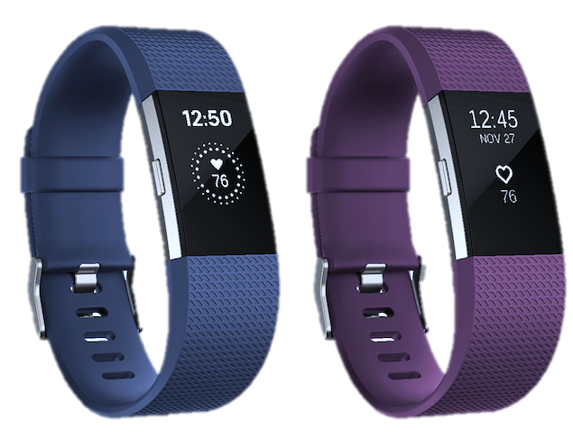
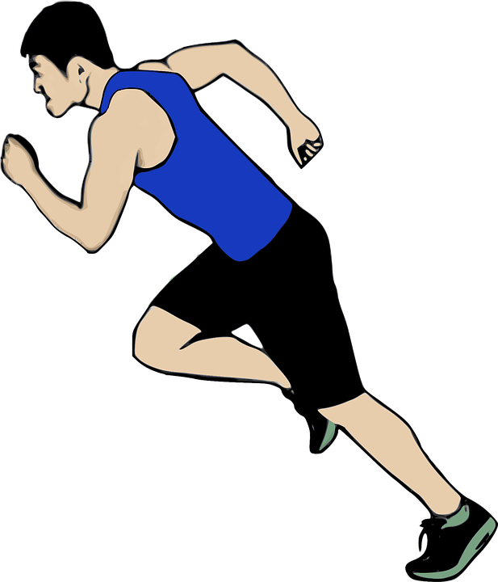


PREDICTIONS USING FITNESS TRACKERS

Slide 2





THE TEAM – GROUP C
Joyce Wigwe
Kelly Wong
Travis Cooper
Jose Cherian
Qaseem Hasan

Slide 3
01
Rationale For Topic

Slide 4
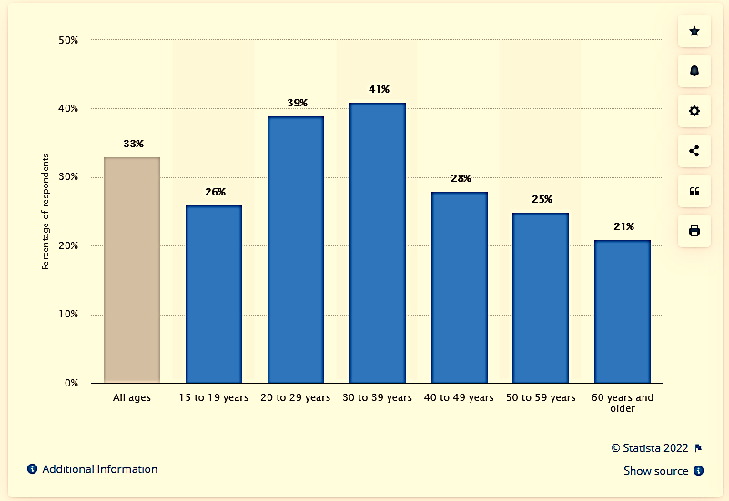
Rationale For Topic
With the increased use of technology for work and as countries grow economically, according to WHO, one in every 4 adults are inactive and as high as 70% of the population are inactive due to changing transport patterns.
Reference: https://www.statista.com/statistics/742448/global-fitness-tracking-and-technology-by-age/

Slide 5

HYPOTHESIS
Mobile health trackers can be used to predict future health data parameters for individuals so that proactive action may be taken if the data parameter falls outside certain boundaries

Slide 6
02
DATA SOURCE

Slide 7

Data Source
After a careful review of data from several different data sources, we opted to use the PMData which comprises a lifelogging dataset of 16 persons over a period of 5 months using fitbit, google forms and PMSys.
https://www.kaggle.com/datasets/vlbthambawita/pmdata-a-sports-logging-dataset/discussion
Notes:
PMSys is a sport athlete monitoring system

Slide 8

03
Data Exploration (Analytical Process)

Slide 9









ANALYTICAL PROCESS
Cleaned Data using Pandas
Grouped by dates and merged participants per parameter
Created Box and Whisker plot to identify central tendency measures
Converted Data from JSON to CSV
Using SQL commands on PgAdmin4 imported tables from local to pgAdmin4 using Heroku host
Created ERD Diagram using Quick DBD platform
Created account on account for Data storage
Created Dashboard into Tableau Desktop then developed alert system and list for selected ranges
Used LGBM Regressor for Machine Learning and calculated MAPE
This Photo by Unknown Author is licensed under CC BY-NC

Slide 10

03
Data Exploration (Exploratory Phase)

Slide 11
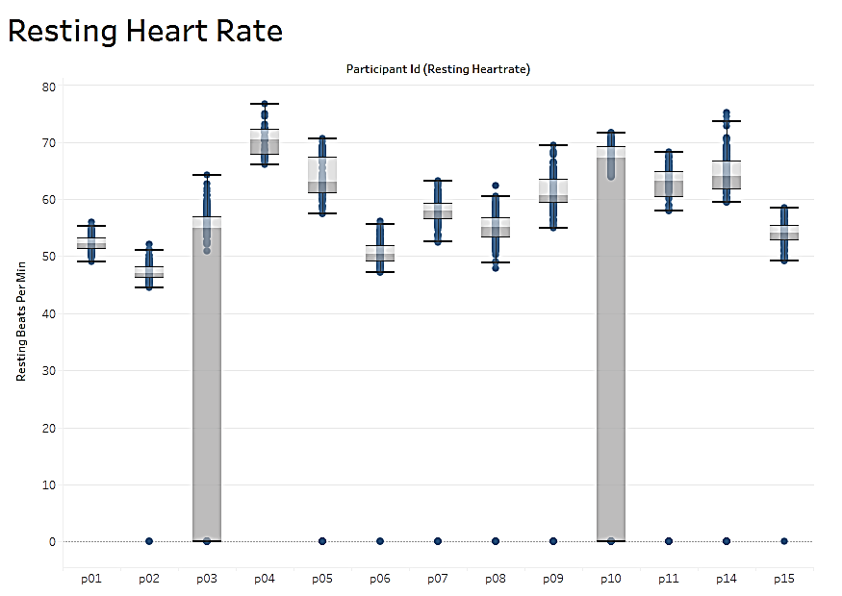

Exploratory Phase
Using Box plots, We observed some zero values for some of the metrics for individual participants, we made the decision to remove these values as we felt this were null values or the results of participants not taking the readings on these days

Slide 12
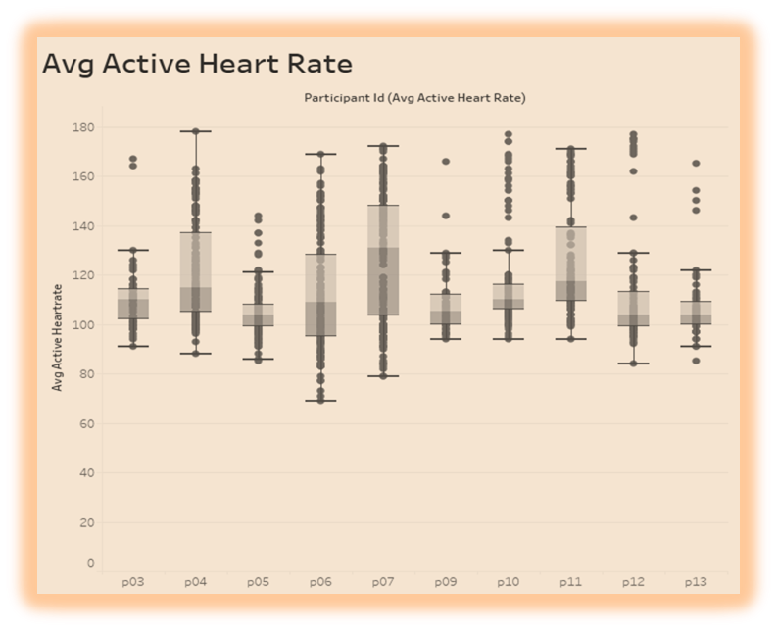
Exploratory Phase
Using Box plots, We observed some zero values for some of the metrics for individual participants, we made the decision to remove these values as we felt this were null values or the results of participants not taking the readings on these days

Slide 13
03
Data Exploration (Analysis Phase)

Slide 14
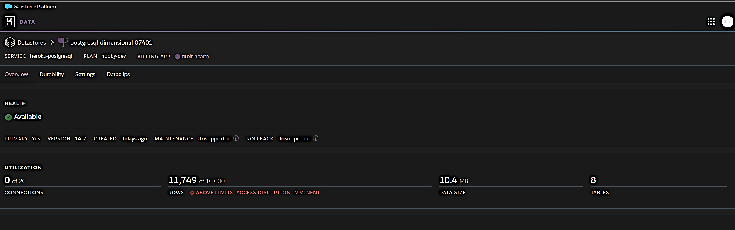
AnaLYSIS OF DATABASE
Removed participant 16 and some heart rate data for participant 01 and 02 from original dataset in order to get under row limit in Heroku
Active Heart Rate dataset had multiple entries per day per participant. Created a view in database to display average active heart rates per day per participant

Slide 15


Machine Learning
This Photo by Unknown Author is licensed under CC BY

Slide 16


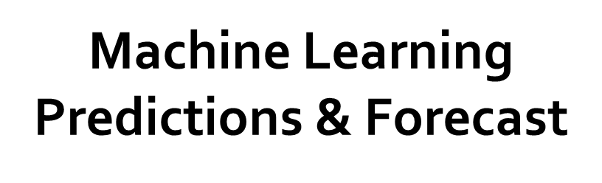
1) Our goal is to use the available data to forecast for at least a year
2) In an effort to arrive at good results, investigated 5 different machine learning models, namely ARIMA, PROPHET, LGBM Regressor, ARIMAX, SARIMA. In absence of good results, we opted for LGBM Regressor

Slide 17

Machine Learning
LGBM model allows for data to be trained according to time periods.
Used hourly time periods in the original datasets, and hourly method to train the LGBM model
Testing data was the last 7 days from the original dataset
Training data was all data up to the last 7 days of the original dataset
Evaluated the ML models using MAPE (MAPE = abs(predicted value - test value) / abs(test value) * 100%)

Slide 18
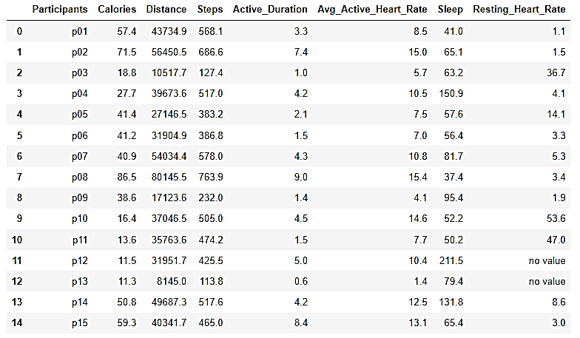
Machine Learning MAPE

Slide 19
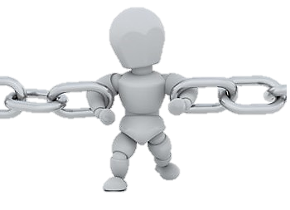
05
Constraints

Slide 20
Constraints
It was difficult to find dataset in terms of parameters that we wanted to work on
Based on research, the LGBM model should have more than 10,000 data points to provide suitable predictions
Difficulty extrapolating data such as resting heart rate of some participants
Limited storage of data on Heroku

Slide 21
06
DASHBOARD
Made with Tableau Public
https://public.tableau.com/app/profile/kelly5613/viz/Final-Project_16541248140270/Dashboard?publish=yes

Slide 22
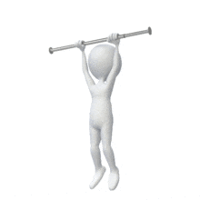
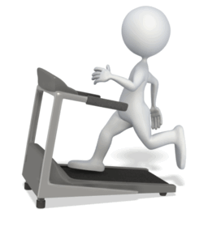

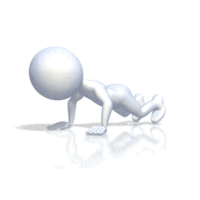
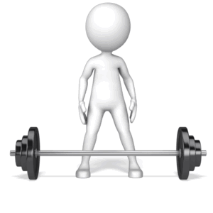
05
CONCLUSION

Slide 23
CONCLUSION
1) For certain data parameters our model provides good predictions such as active duration and active heart rate, however for other data parameters the model’s predictions are not accurate.
2) For future analysis, we would recommend examining additional ML models to ascertain whether they would provide better MAPE results over LGBM for problematic data parameters such as distance.

Slide 24
CONCLUSION
3) Additionally, we would recommend incorporating APIs to retrieve data for participants from fitness tracker companies.
4) Incorporate data parameters, such as: weight, blood sugar; and ability to record data in different units (such as: Kilograms, pounds, stone)
5) Things we would do differently: instead of removing all zeros from all data parameters, we would only remove the zeros from some data parameters.

Slide 25


THANKS!
Questions
Checkout GitHub:
https://github.com/qaseemme064/Final-Project

